Slide 1

Team Edge
Adarsh B. Londhe Rahul R. Kanade
Vishwakarma Institute Of Technology, Pune

Slide 2
Cloud Kitchens
Theme 2
An Online Platform For Messes
(Messes: Plural for Mess)
Mess: Place where meals are served to a group

Slide 3
Introduction
An Online Platform For Messes.
Connecting Mess Owners And Consumers.
Mess Recommendation Based on Consumers Current Location And Preferred Choice Of Cuisine.

Slide 4
Social Drivers
Home Cooked Healthy Food For Students, Employees, Hostellites etc.
Food Of Preferred Cuisine eg. Maharashtrian, Andhra Food etc.
Platform For Small Scale Mess Owners To Grow Their Business
Women Empowerment

Slide 5
Technology Drivers
Smartphone Availability.
Cheap Internet Access.
E-commerce.

Slide 6
Economic Drivers
Ad-Based Business Model.
Global Scale

Slide 7
Proposed Features
Mess Owners
Mess Registration
Managing Clients
Easy Communication with Clients
Feedback Analysis
Logistics Management
Consumers
Mess Recommendation
Managing Mess Subscription
Easy Communication
Reviews And Ratings
Online Payment

Slide 8
Technologies Used For Making Developing Prototype
Front-End -
HTML5, CSS3, Javascript, jQuery, Bootstrap4
Back-End -
Node.js, Express
Database -
PostgreSQL

Slide 9
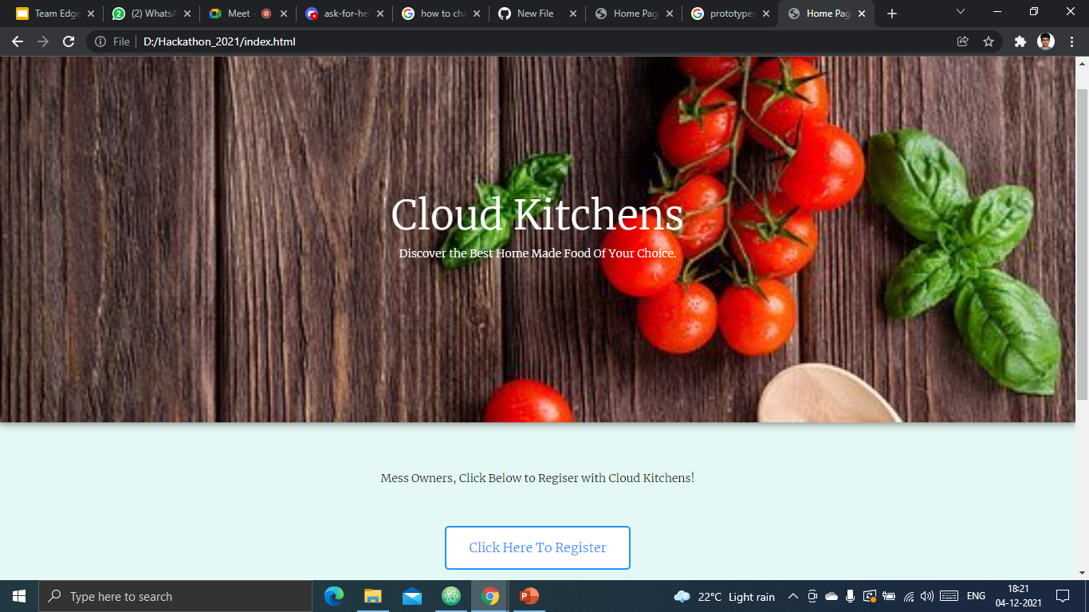
ScreenShots Of The Project Prototype
Home Page Of The Website.

Slide 10
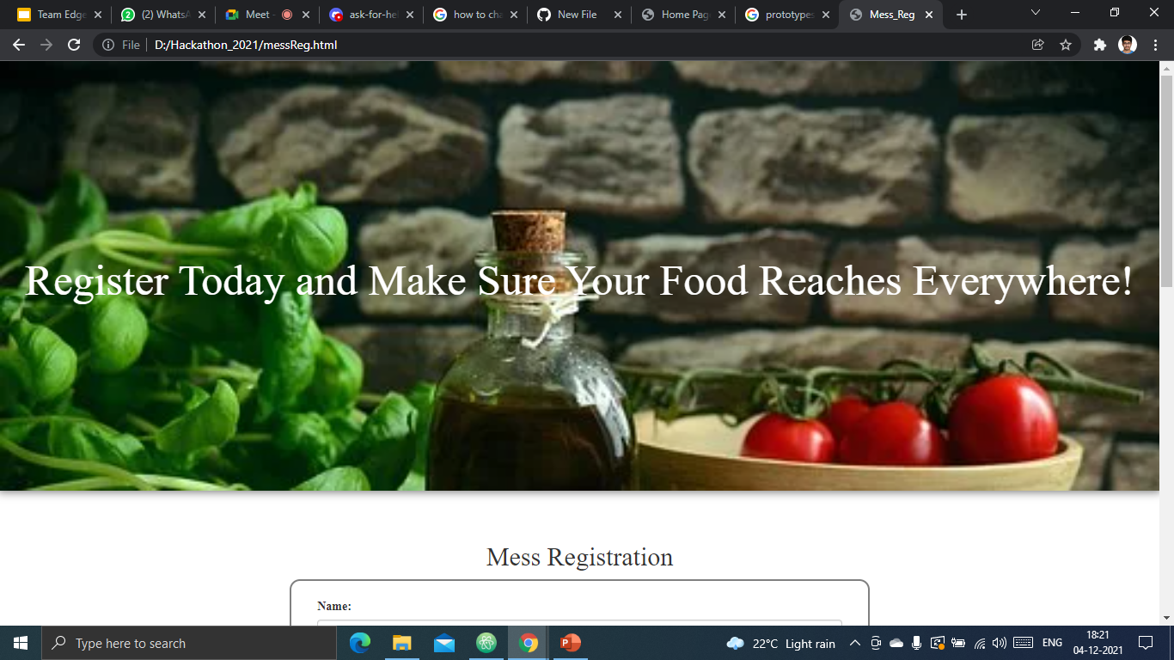
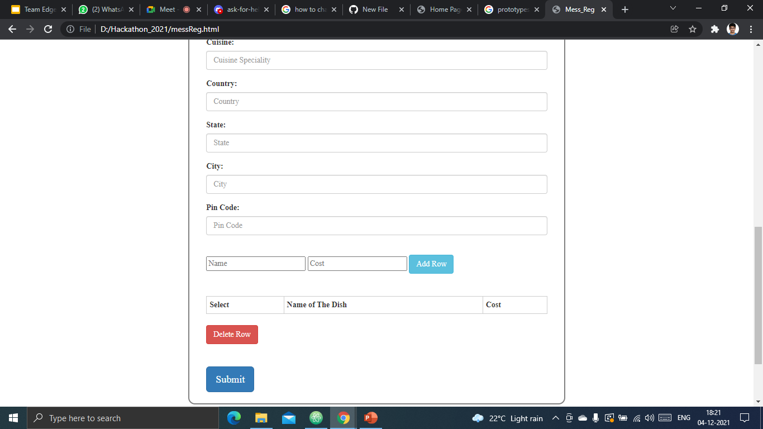
ScreenShots Of The Project Prototype
Mess Registration Page

Slide 11
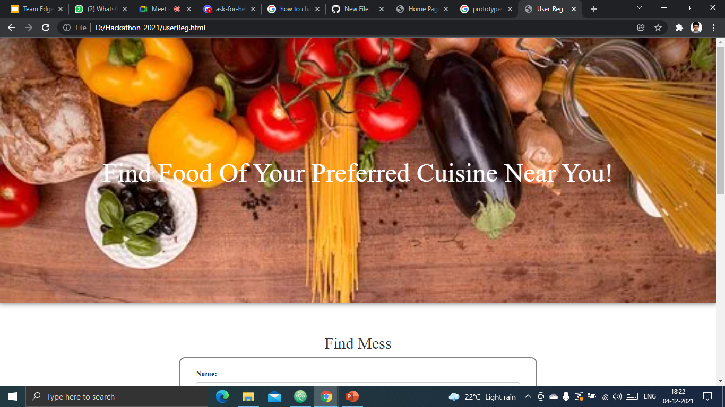
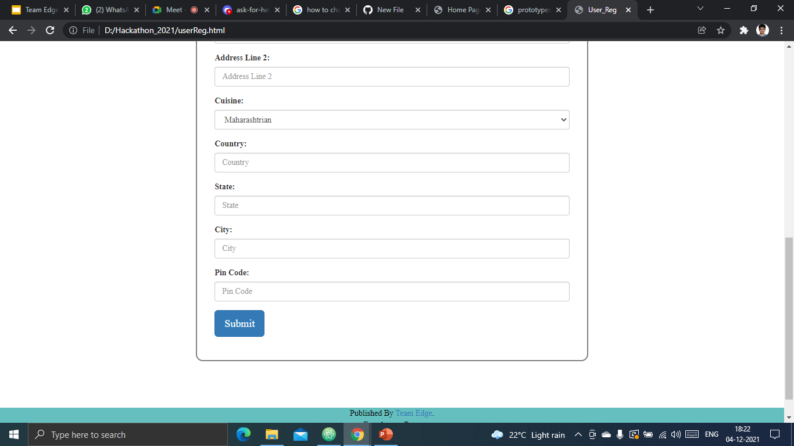
ScreenShots Of The Project Prototype
Mess Recommendation Page

Slide 12
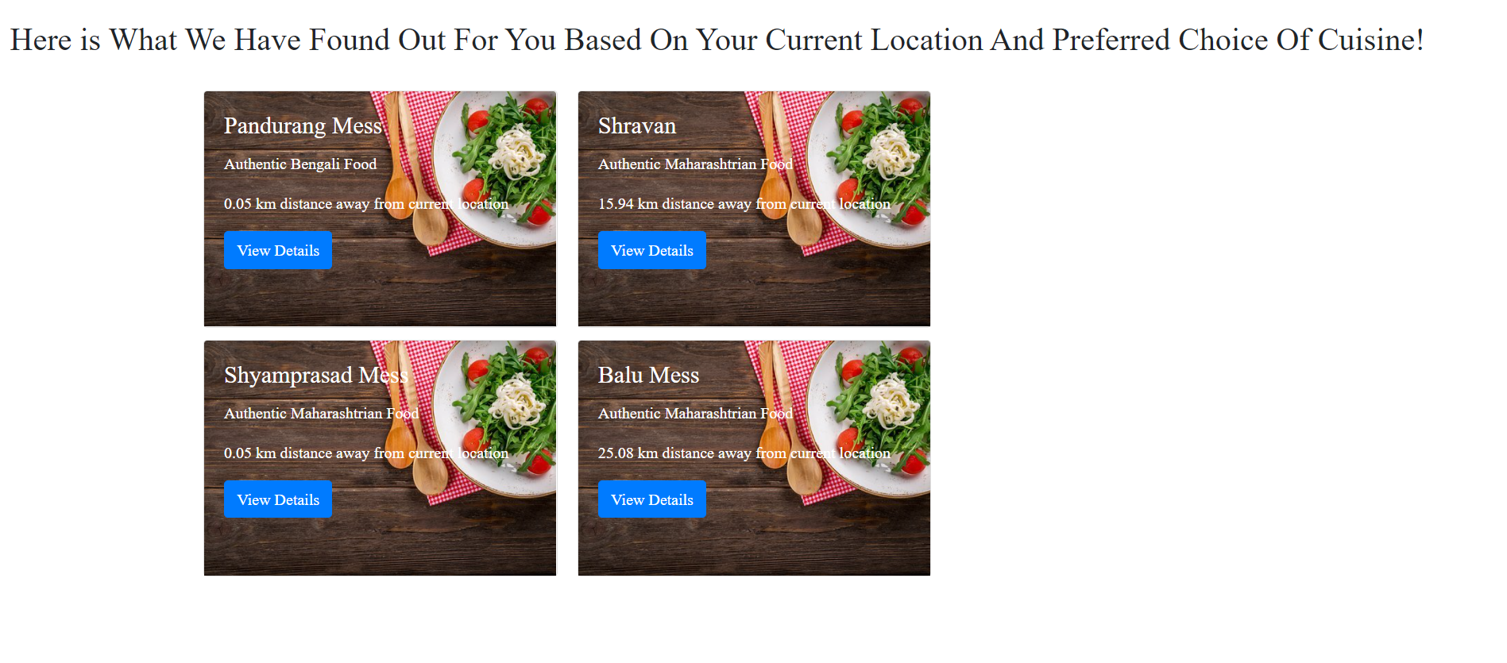
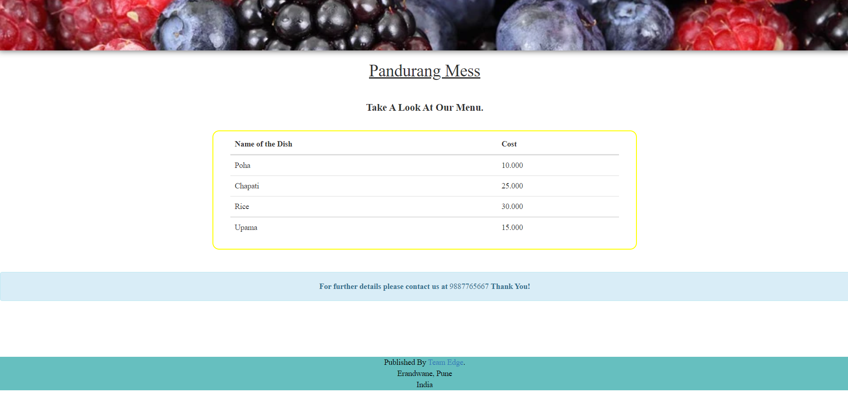
ScreenShots Of The Project Prototype
Recommended Mess Mess Details

